Slide 1
負電性低密度脂蛋白L5
與心血管疾病
Electronegative Low-Density Lipoprotein and Atherosclerosis
Chao-yuh Yang, Ph.D.
楊朝諭 教授
美國貝勒醫學院醫學系及生化系
中國醫藥大學附設醫院, L5研究中心
Academy BioMedical Company

Slide 2
Atherosclerosis and low-density lipoproteins
Atherosclerosis is the leading cause of death in the western country.
Atherosclerosis causes significant morbidity and mortality, and associates with enormous economic impact.
Increased levels of low-density lipoproteins (LDLs) are associated with increased risk for development of atherosclerosis.

Slide 3
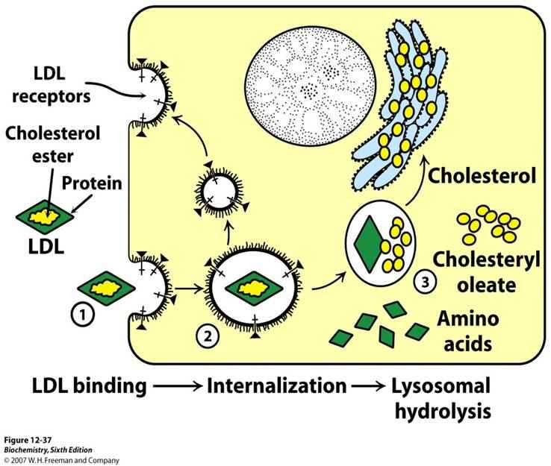
1983 Brown and Goldstein et. al reported in New Engl. J. Med: Defective lipoprotein receptors and atherosclerosis.
1985 Brown and Goldstein et. al reported structure for lipoprotein receptors in Science and reported receptor-mediated endocytosis: concepts emerging from the LDL receptor system in Ann. Rev. Cell Biol..

Slide 4
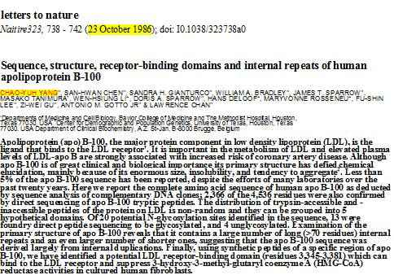

Slide 5
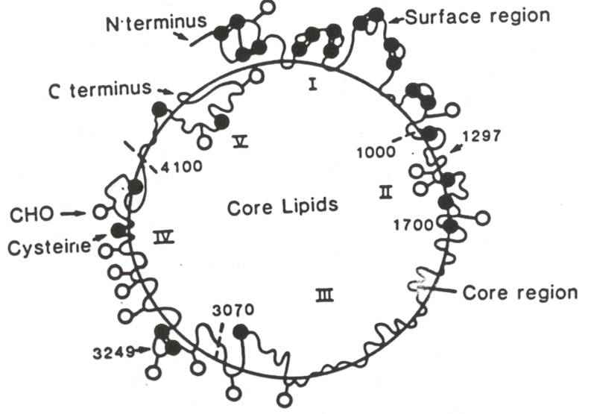
ApoB-100 structure in LDL

Slide 6
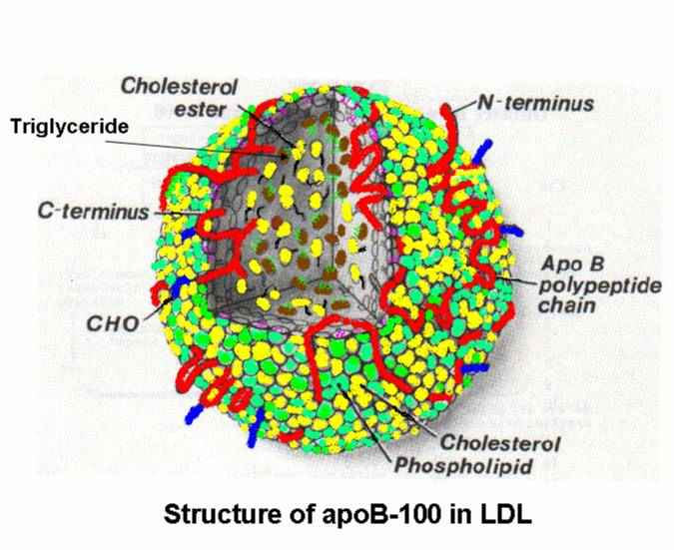
ApoB-100 Structure in LDL

Slide 7
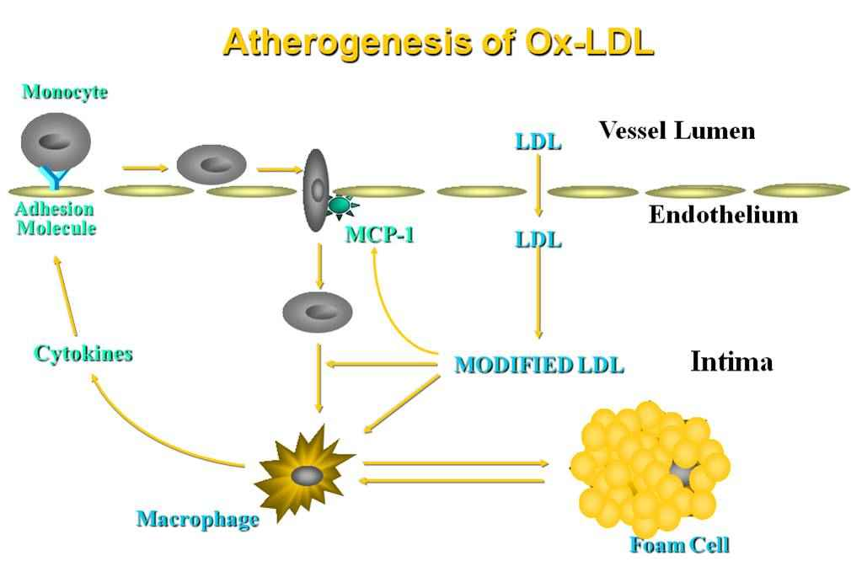

Slide 8
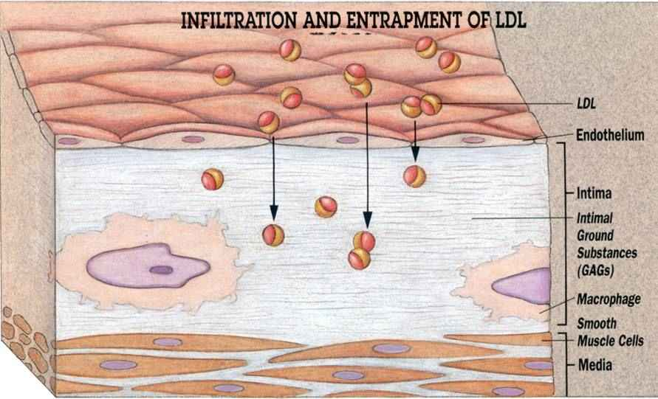
Steps in atherogenesis

Slide 9
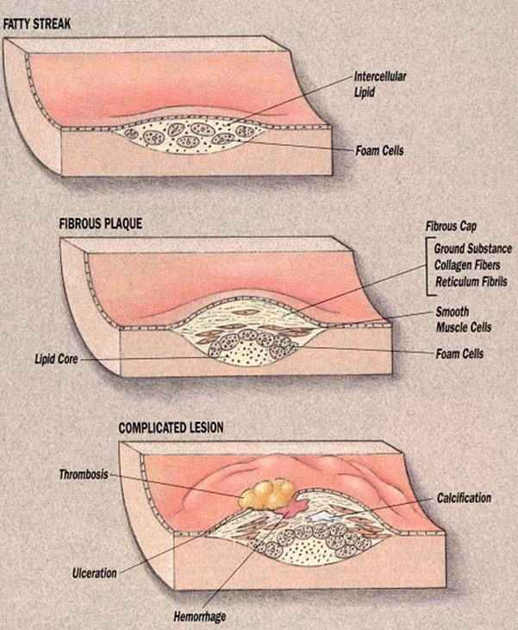
Stages of atherosclerosis

Slide 10
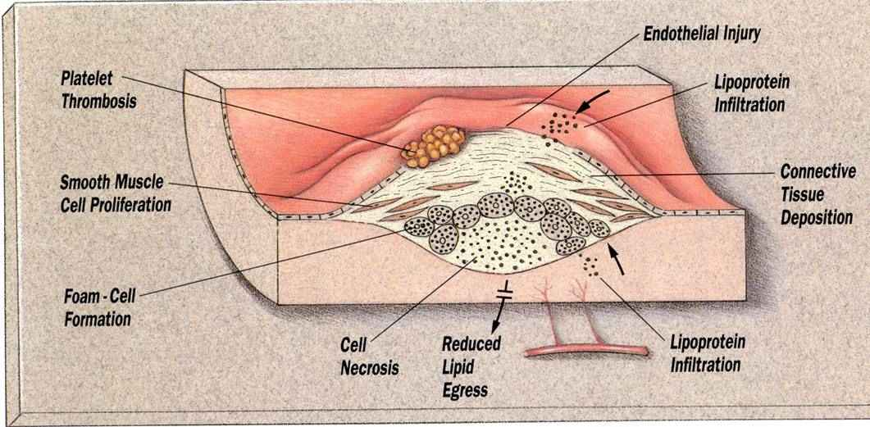
Pathologic processes leading to the development of an atherosclerotic plaque

Slide 11
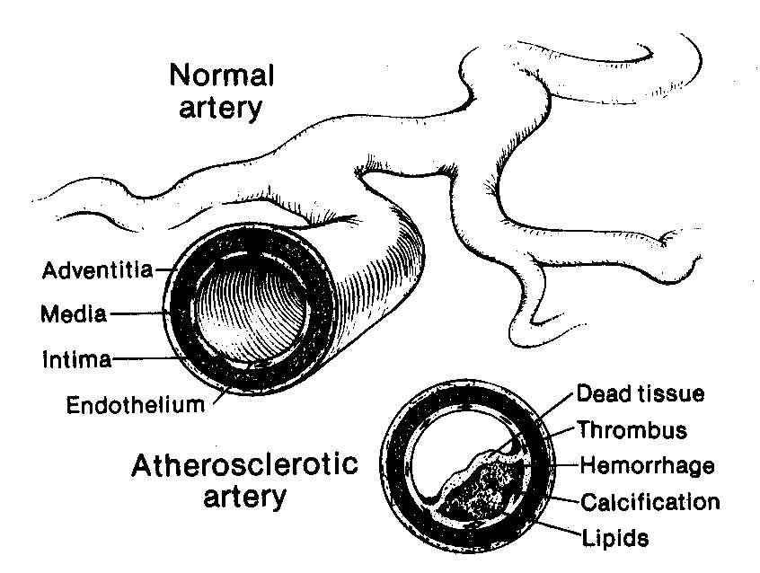
The three layers of the arterial wall

Slide 12
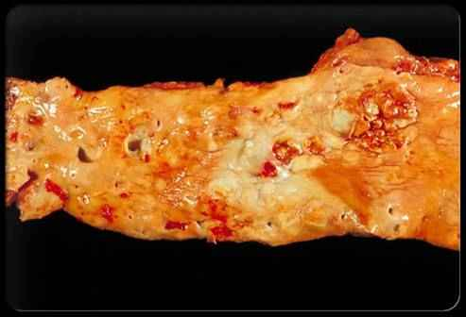
Atherosclerosis
Heart disease begins when cholesterol, fatty material, and
calcium build up in the arteries, a process known as atherosclerosis.

Slide 13
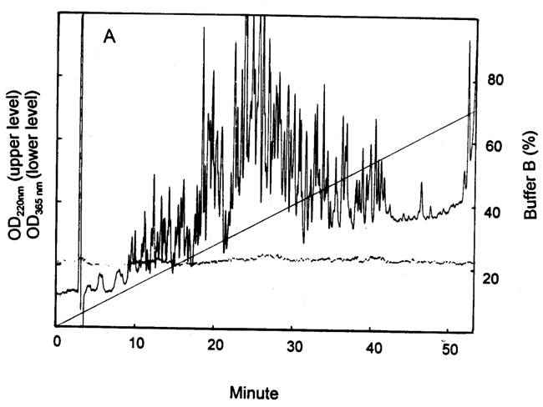
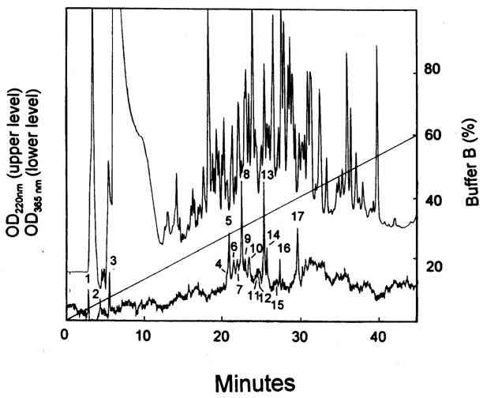
HPLC of Cu ox-apoB tryptic peptides
Notes:
TFA buffer system, A: N-LDL, B:Cu ox N-LDL

Slide 14
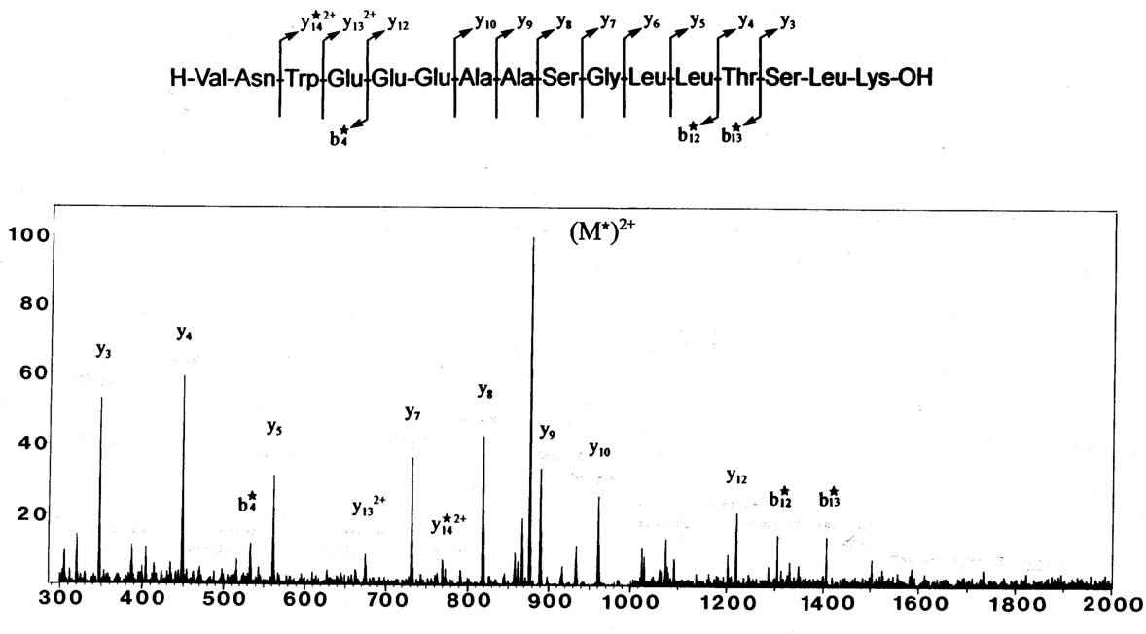
Electrospray-MS of Cu ox-peptide

Slide 15
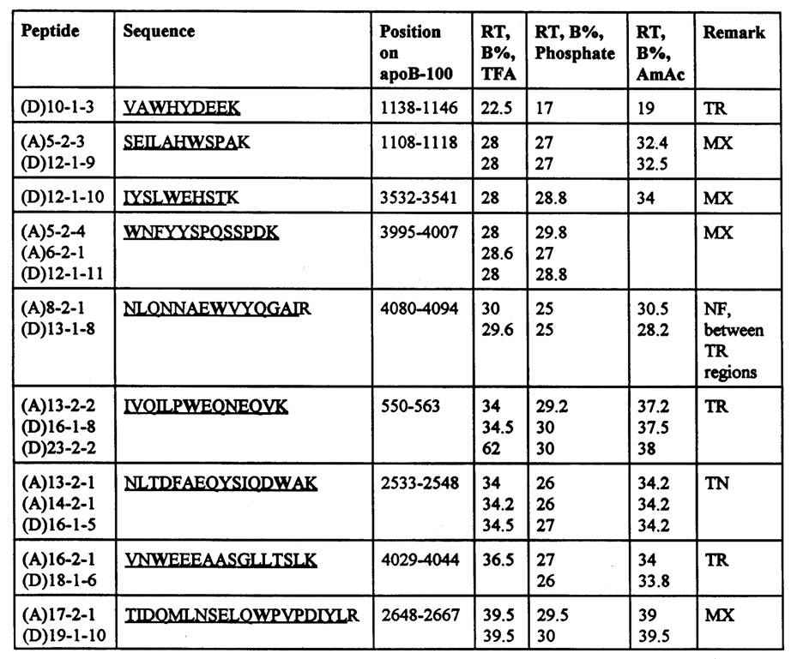
Purified Cu ox-peptides
Notes:
9 trp peptides

Slide 16
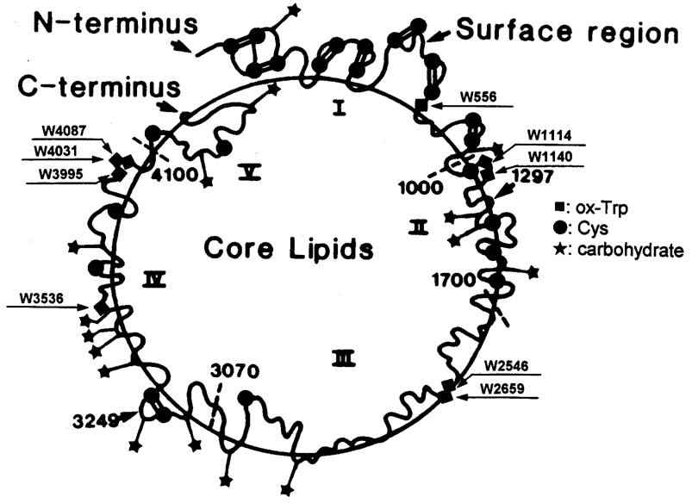
Location of Cu ox AA residues on LDL

Slide 17
Summary ----in vitro ox-LDL
Copper ox-LDL results in a) formation of carbonyl group at the Trp residues of apoB-100, b) formation of sulfonic acid, c) formation of HNE-His adducts
Exposure of LDL to HOCl or MPO in vitro generates DNPH-reactive sites on the apoprotein (Cys, Trp, Lys)
Oxidation of LDL by MPO is remarkably more selective than is oxidation by HOCl in free solution, suggesting the formation of some form of enzyme-substrate complex between MPO and LDL

Slide 18
Conclusion ---- in vitro ox-LDL
Different mechanisms of LDL oxidation can be distinguished by specific characteristic products of oxidation of the apoprotein
Most of the modified residues identified so far are incorporated in tryptic peptides shown to reside on the surface of the LDL particle

Slide 19
Oxidative Modified LDL
In vitro
Metal-catalyzed oxidation: copper- or iron-oxidation
HOCl-mediated oxidation
Enzyme-mediated oxidation: myeloperoxidase, lipoxygenases
d. Reaction of LDL with lipid-derived aldehydes,
e. Cell-mediated oxidative modification
In vivo
Circulating LDL
Atheroma LDL

Slide 20
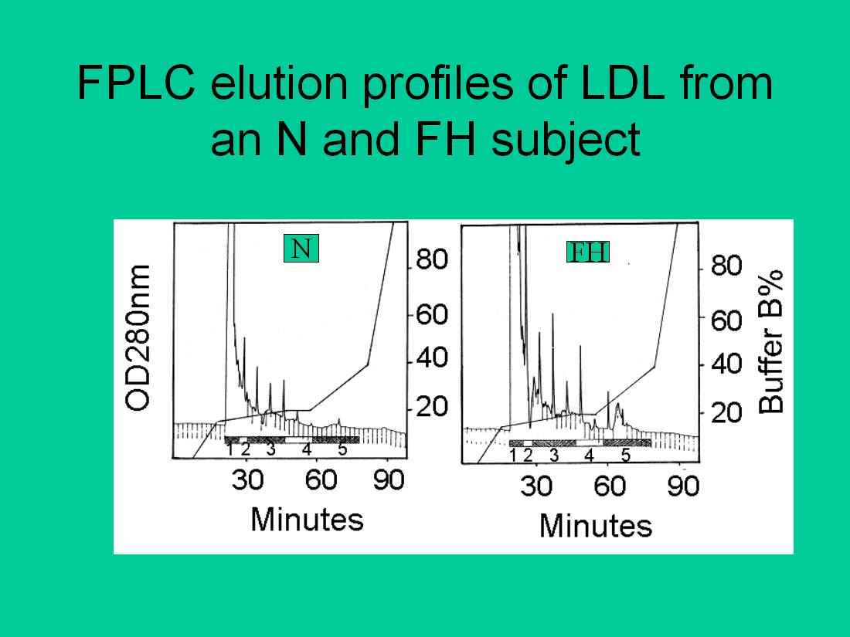

Slide 21
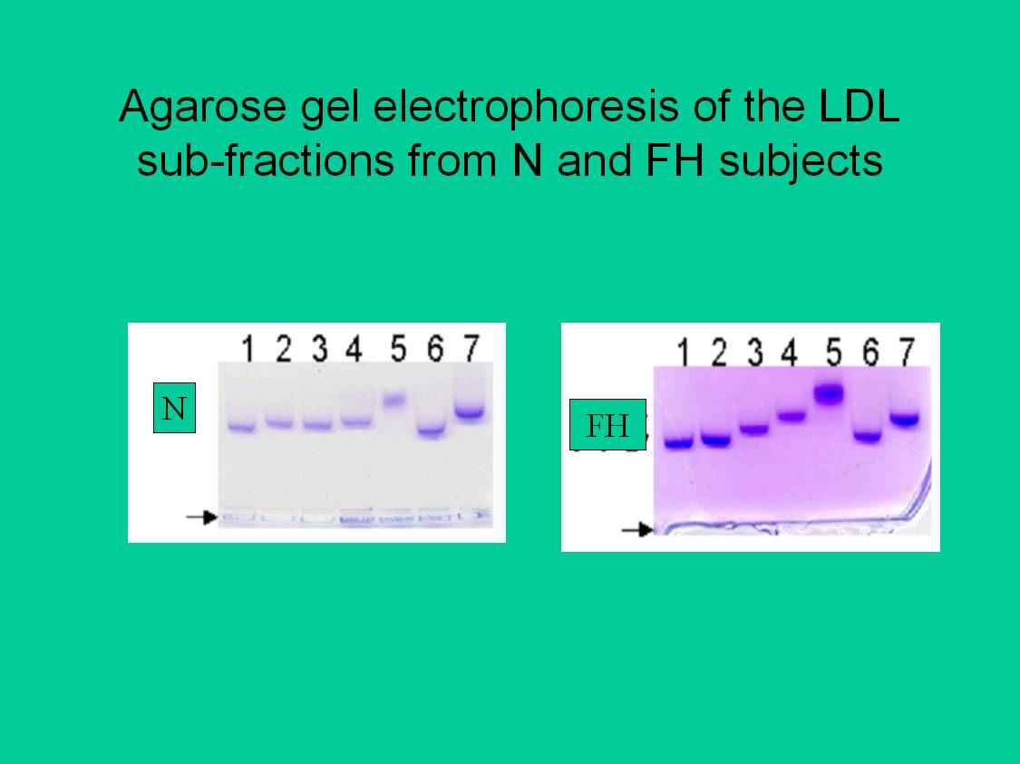

Slide 22
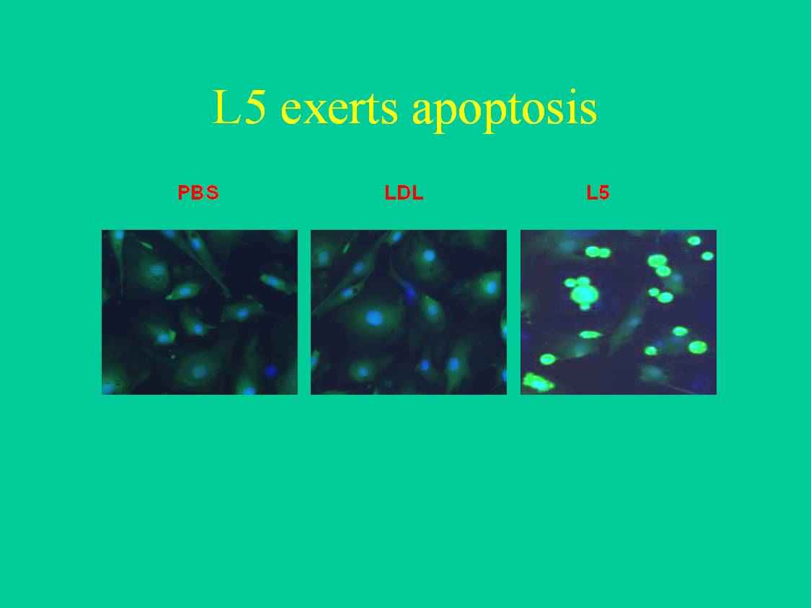

Slide 23
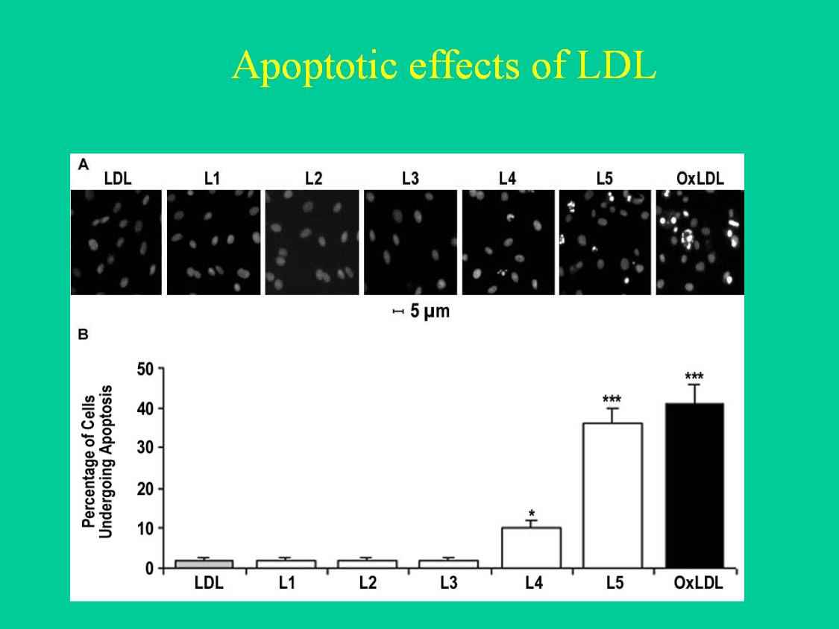

Slide 24
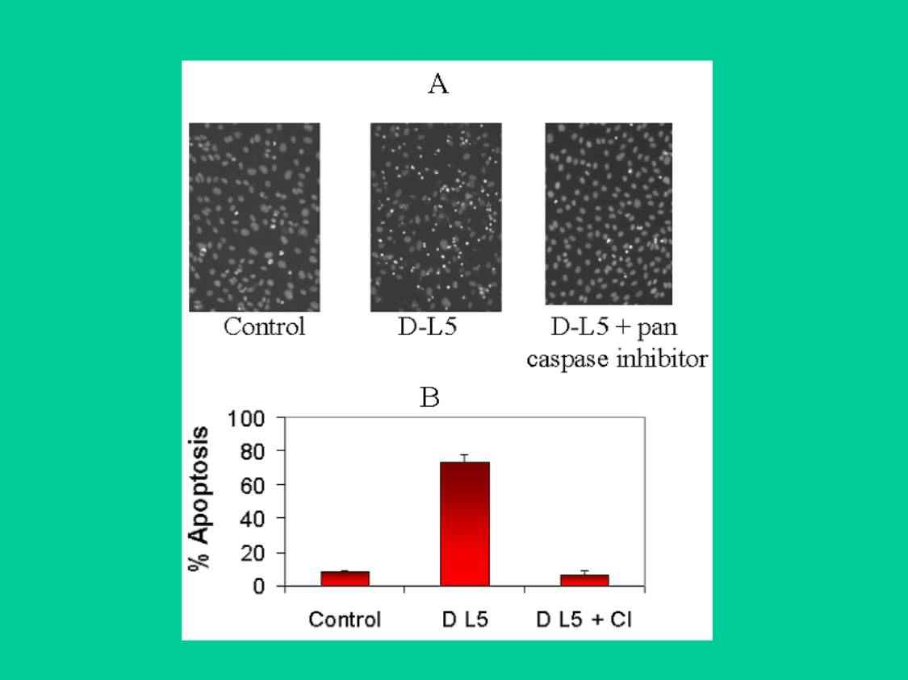

Slide 25
What does L5 do to us?
inhibits EC proliferation
induces EC apoptosis
induces EC expression of adhesion molecules
induces monocyte-EC adhesion
induces VSMC proliferation
inhibits EPC differentiation
Circulation 2003; ATVB 2003; Curr Opin Lipidol 2004; Curr Vasc Pharmacol 2004;
Atherosclerosis 2007-1, 2007-2; Endocrinology 2007; JLR 2004, 2007, 2008;
Diabetes 2008; Circ Res 2006, 2008, 2009-1, 2009-2

Slide 26
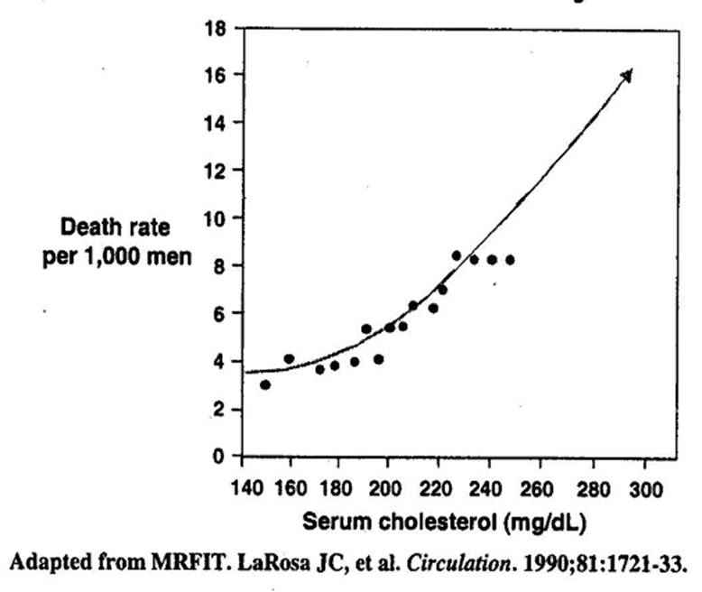
Relation of cholesterol to coronary death

Slide 27
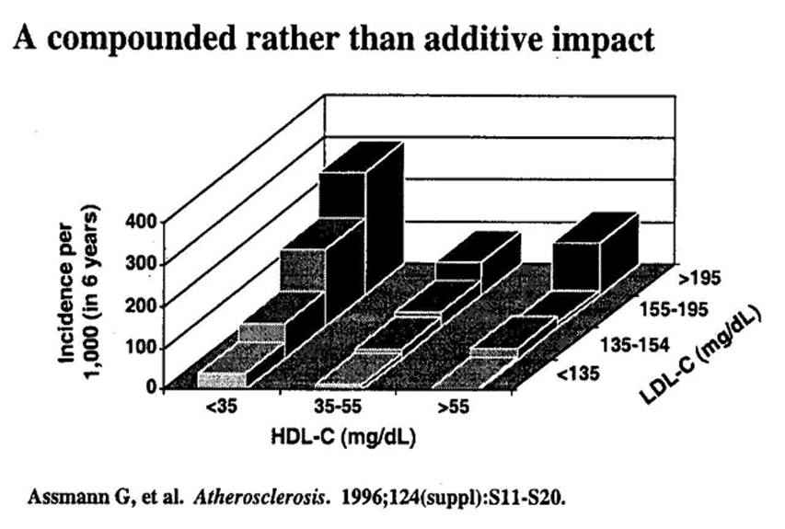
LDL-C and HDL-C impact on CHD risk

Slide 28
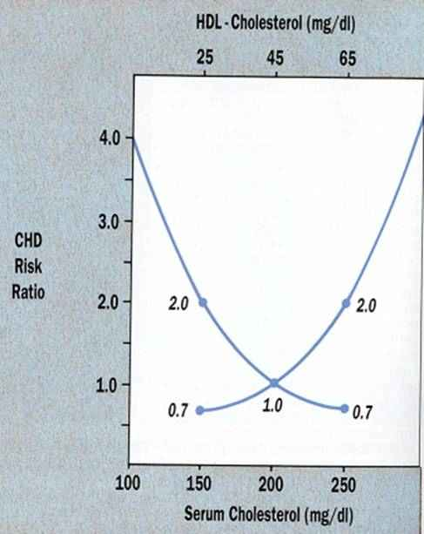
Risk ratios for CHD of total cholesterol and HDL cholesterol

Slide 29
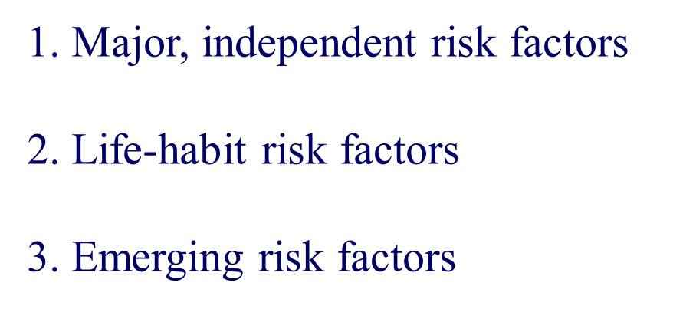
Categories of Risk Factors

Slide 30
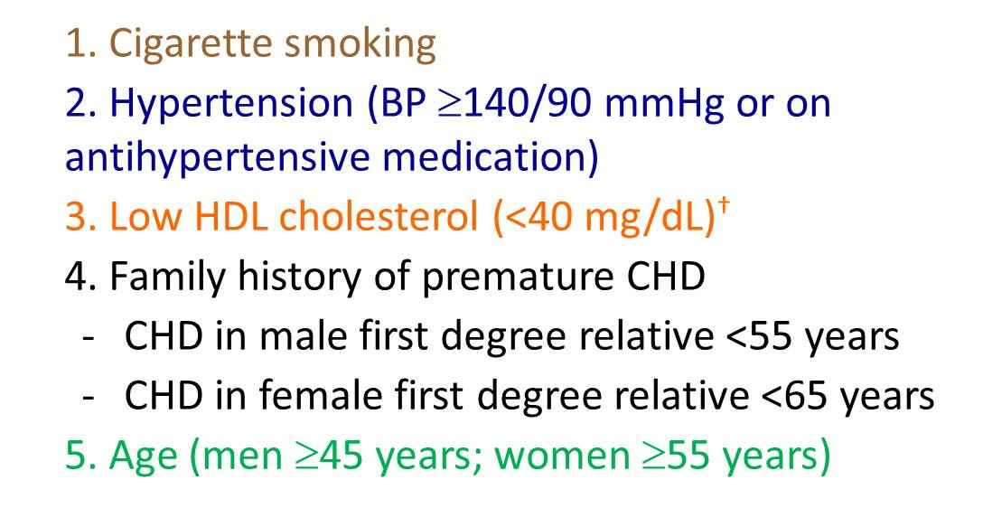
Major Risk Factors (Exclusive of LDL Cholesterol)

Slide 31
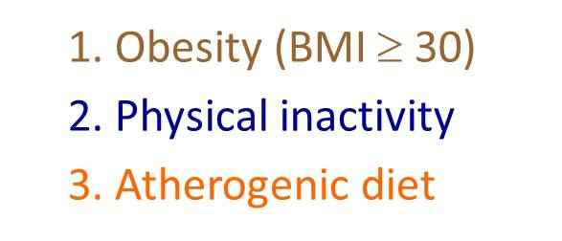
Life-Habit Risk Factors

Slide 32
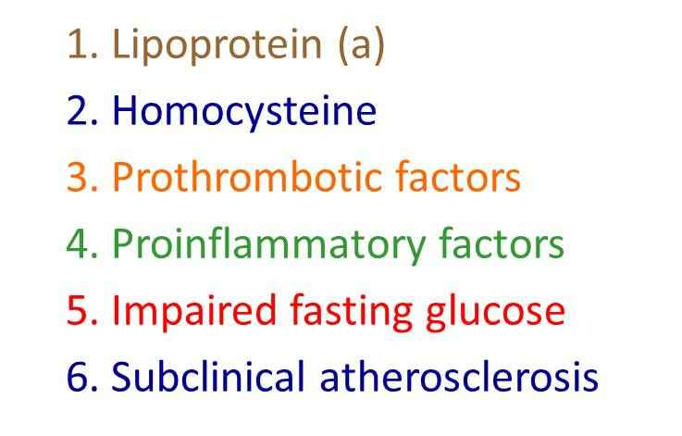
Emerging Risk Factors

Slide 33
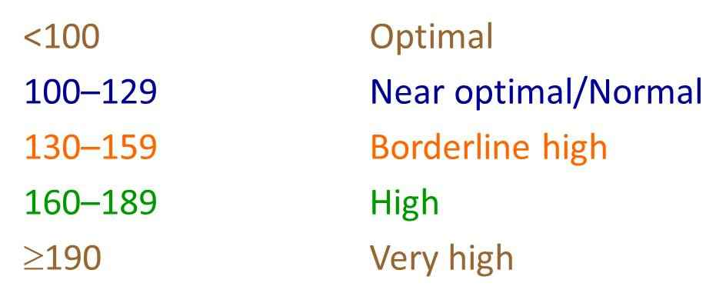
Lipid and Lipoprotein Level Related to health condition
LDL Cholesterol (mg/dL)

Slide 34
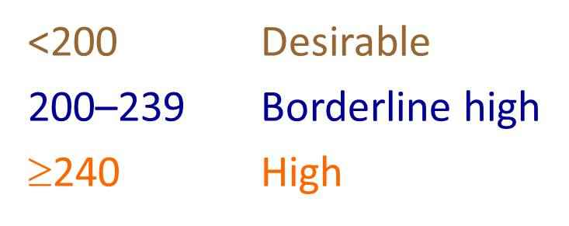
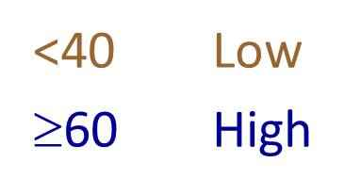
Lipid and Lipoprotein Level Related to health condition
Total Cholesterol (mg/dL)
HDL Cholesterol (mg/dL)

Slide 35
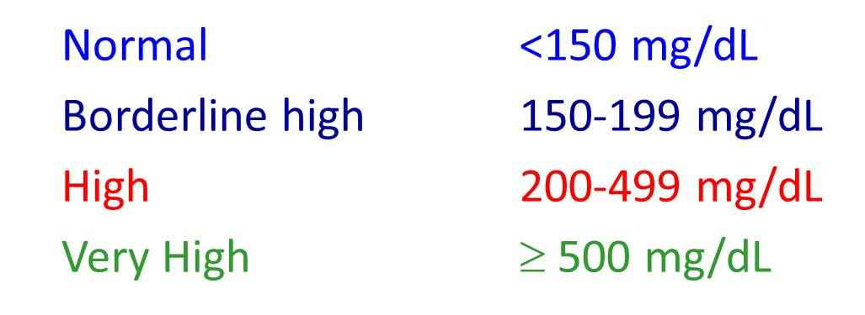
Lipid and Lipoprotein Level Related to health condition
Serum Triglycerides

Slide 36
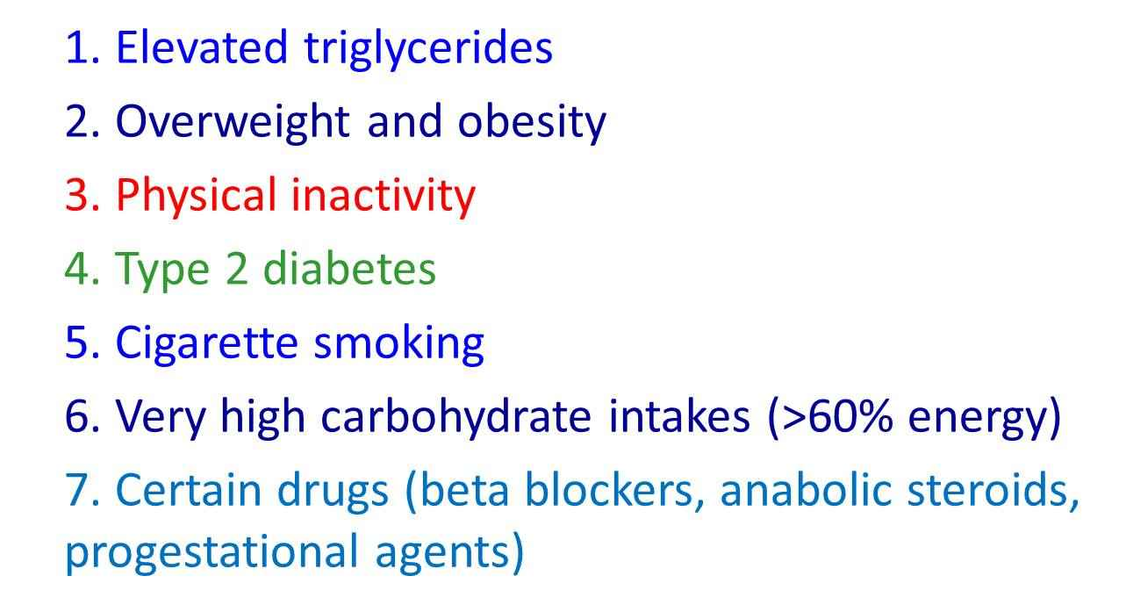
Causes of Low HDL Cholesterol
(<40 mg / dL)

Slide 37
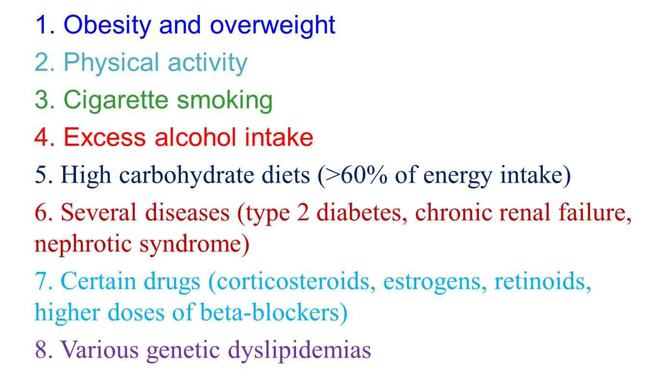
Causes of Elevated Triglycerides
(> 150 md/dL)

Slide 38
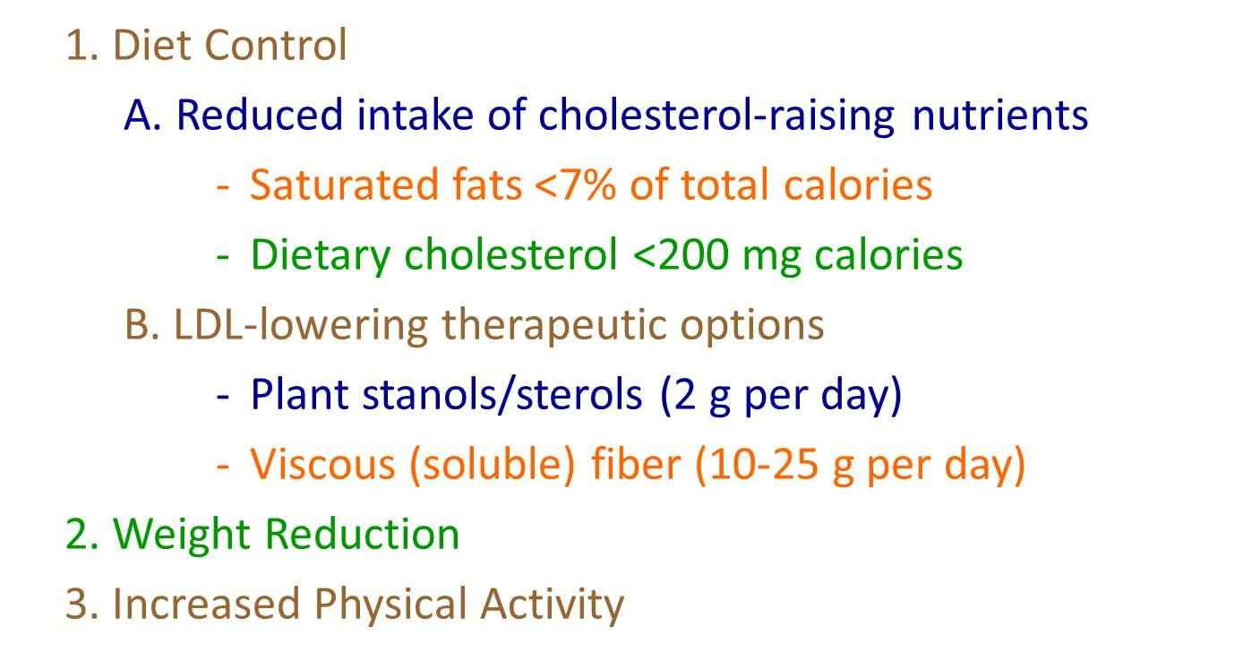
Therapeutic Lifestyle Changes in
LDL-Lowering Therapy

Slide 39
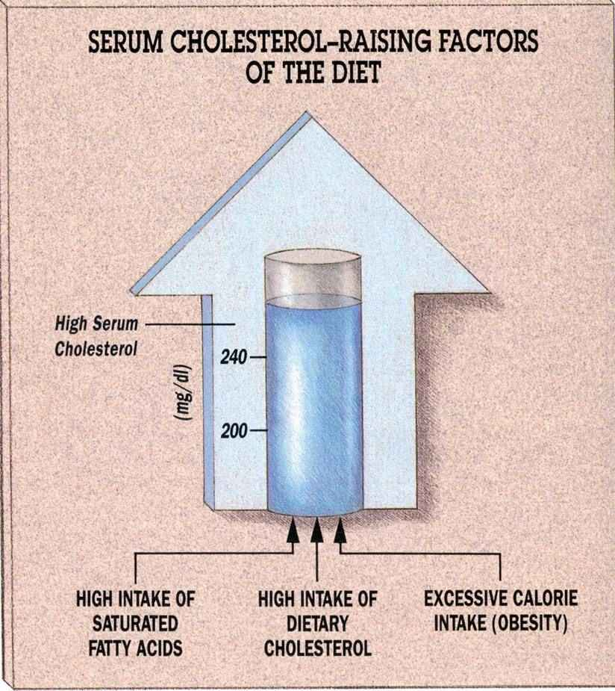

Slide 40
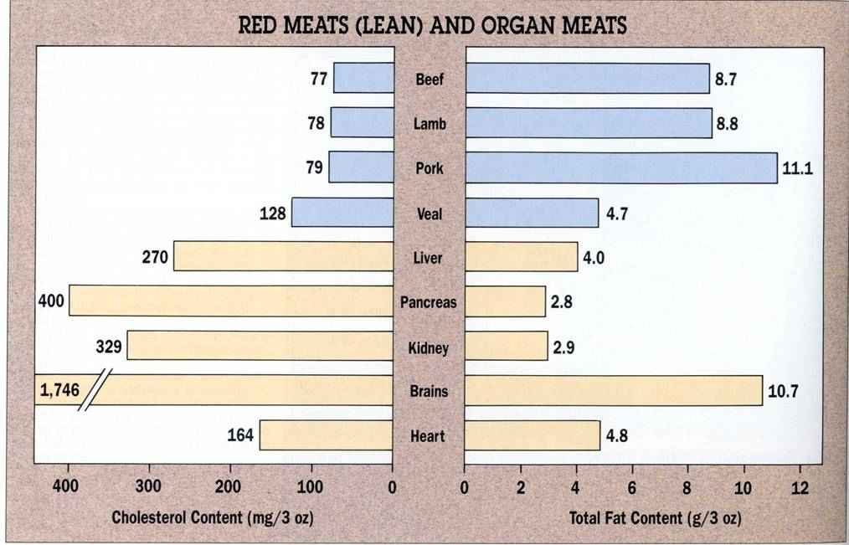
Cholesterol content (mg/3 oz, 85 g) and total fat content (g/3 oz) of lean meats and organs (cooked)

Slide 41
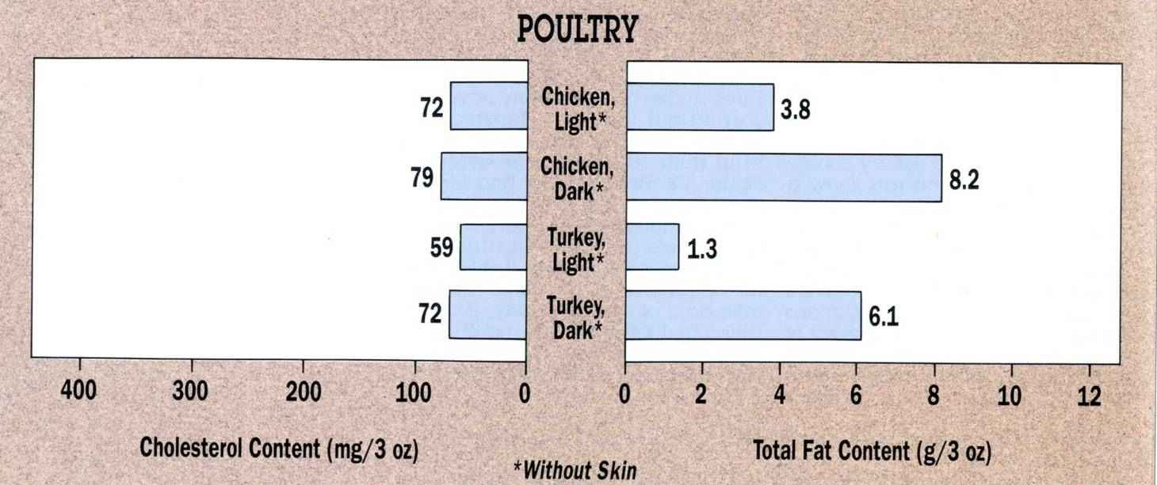
Cholesterol content (mg/3 oz) and total fat content (g/3 oz) of poultry (cooked)

Slide 42
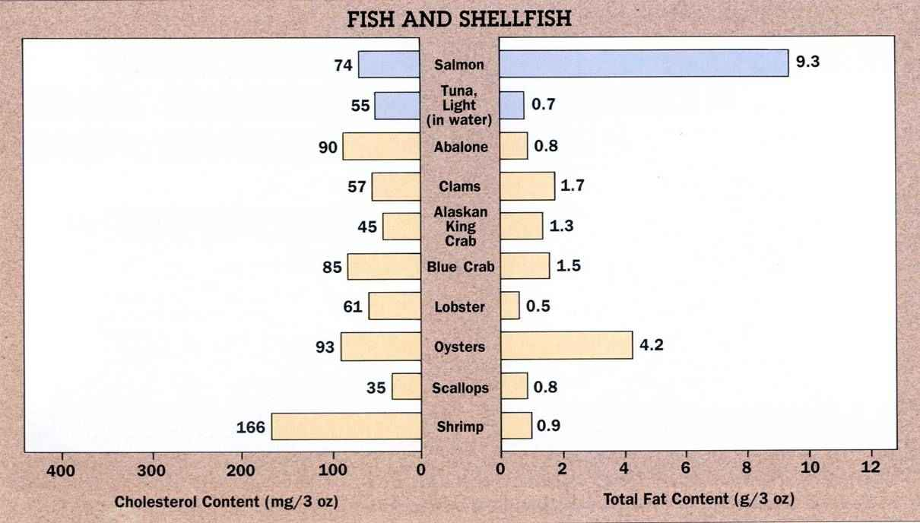
Cholesterol content (mg/3 oz) and total fat content (g/3 oz) of fish and shellfish (cooked)

Slide 43
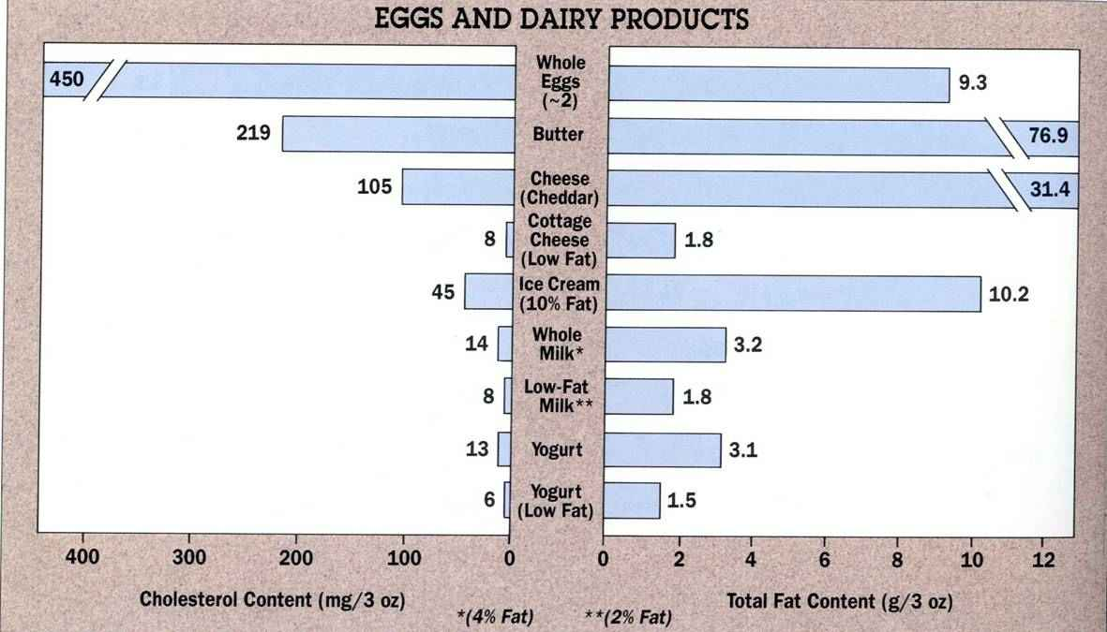
Cholesterol content (mg/3 oz) and total fat content (g/3 oz) of eggs and dairy products (cooked)

Slide 44
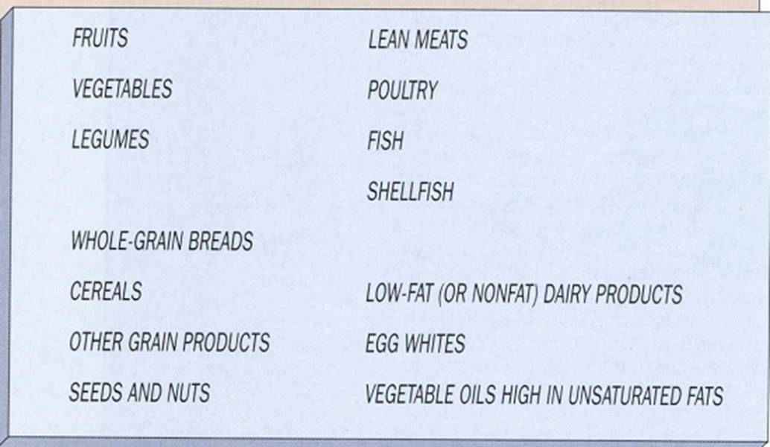
Components of nutritionally balanced cholesterol-lowering diet

Slide 45
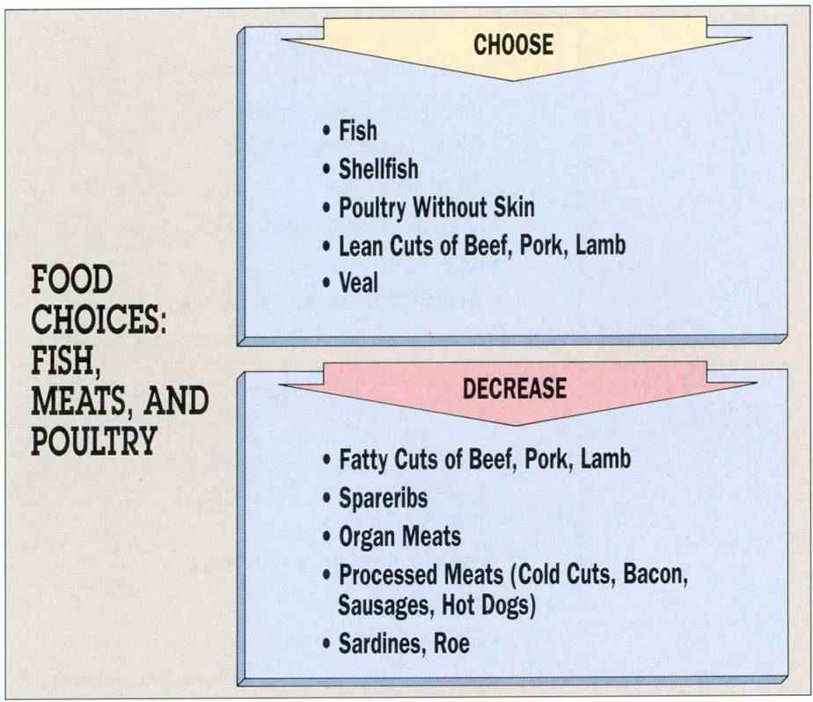

Slide 46
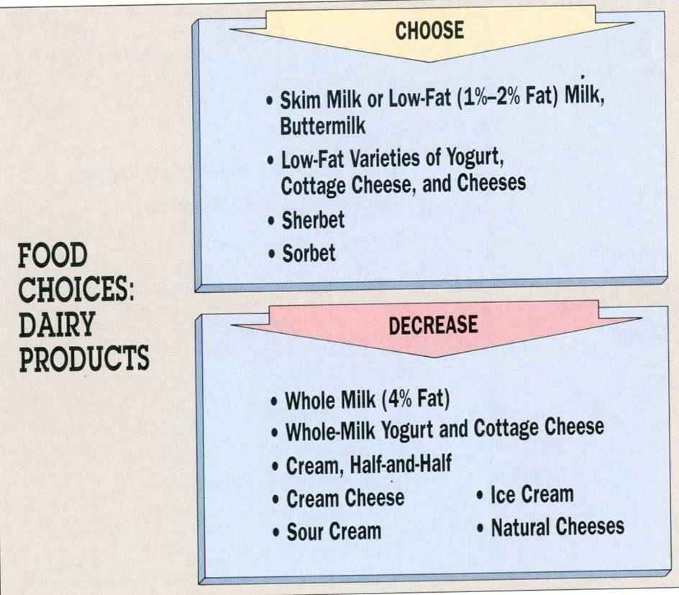

Slide 47
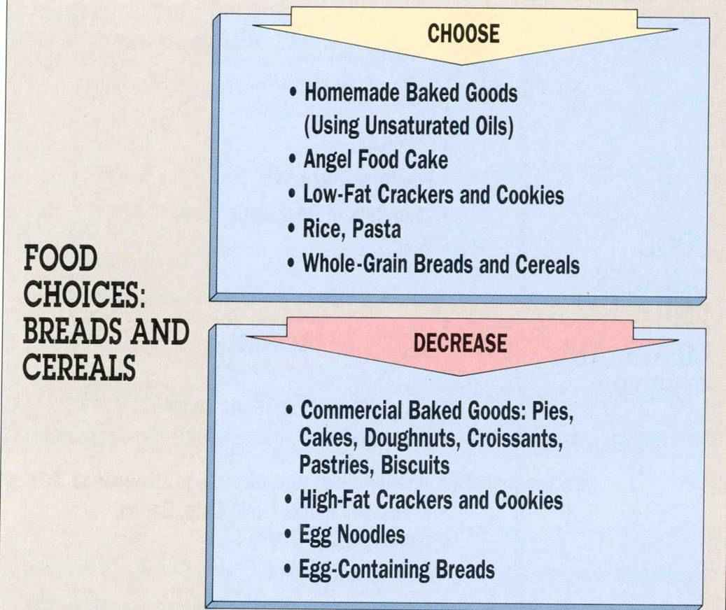

Slide 48
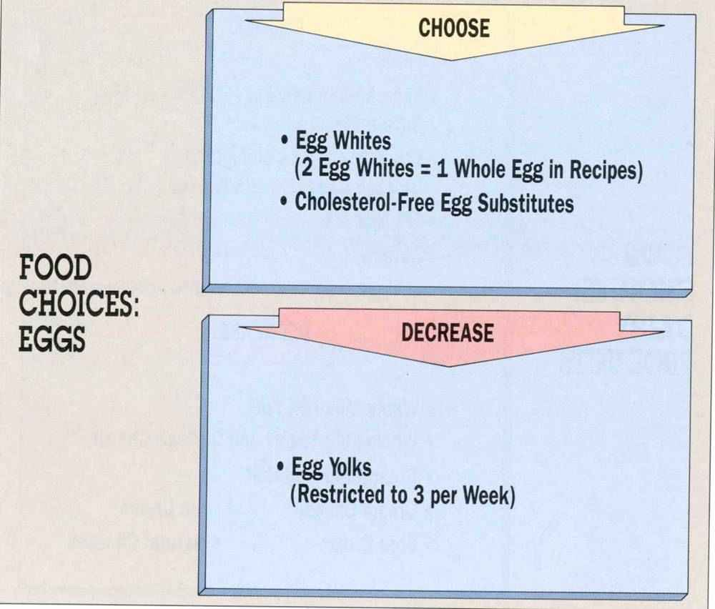

Slide 49
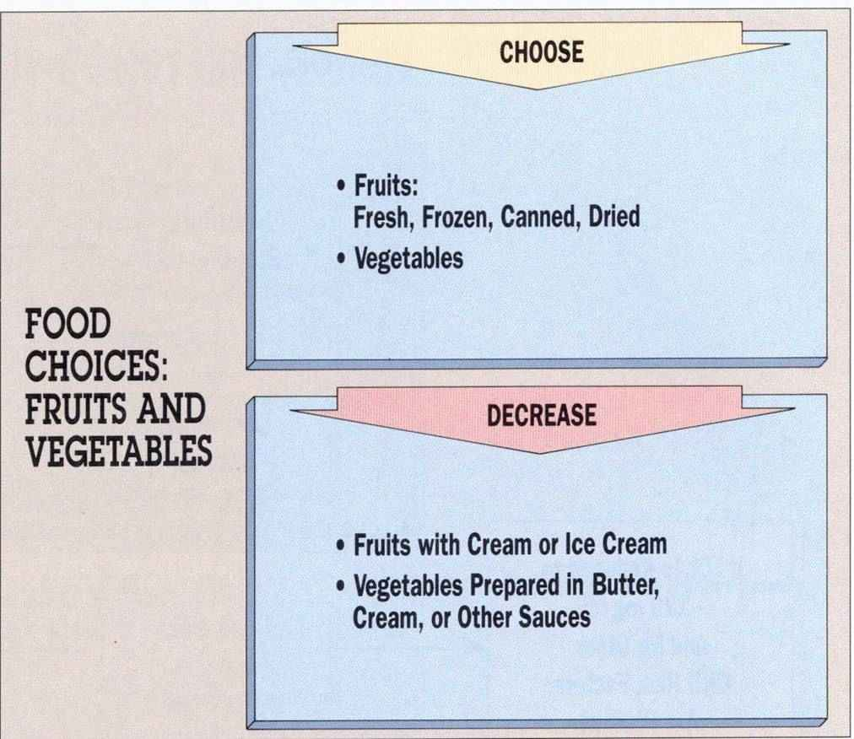

Slide 50
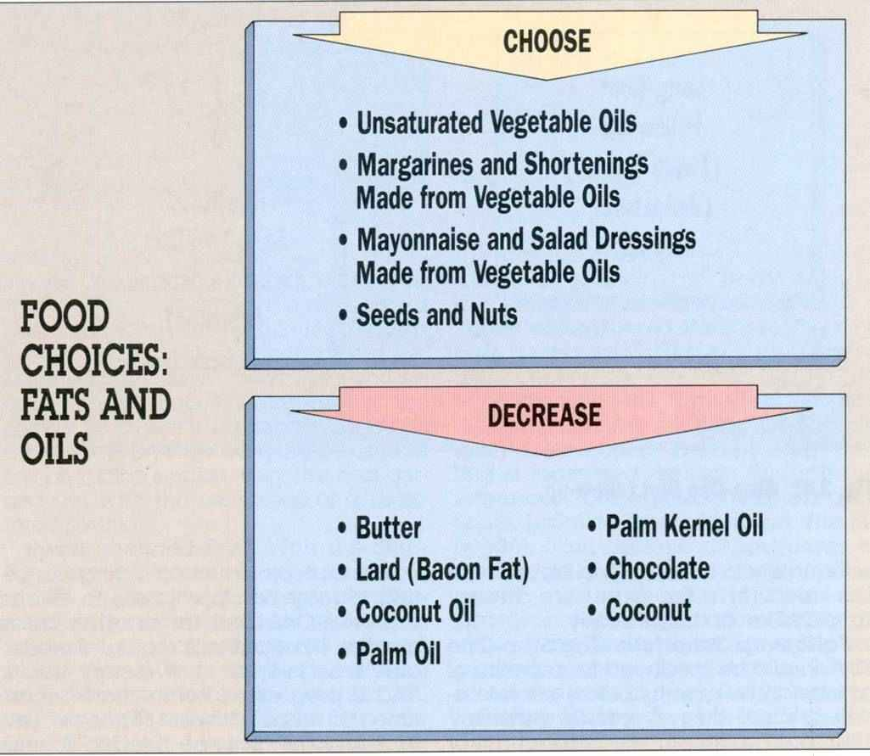

Slide 51
Thank you for your attention

